Slide 1


Major Project
Title: Diabetes Prediction
and
Medicine Recommendation
Presented by:
Name | Roll No. | Branch
Nandini Srivastava | 271223145 | MCA (Data Science)
Tejendra Kumar Panda | 271223158 | MCA (Data Science)
Abhishek Choudhary | 271223153 | MCA (Data Science)
Ashish Kumar | 271223152 | MCA (Data Science)
Mentored By :
Mr. Mrinal Maji
Assistant Professor
SoCS, UPES Dehradun

Slide 2
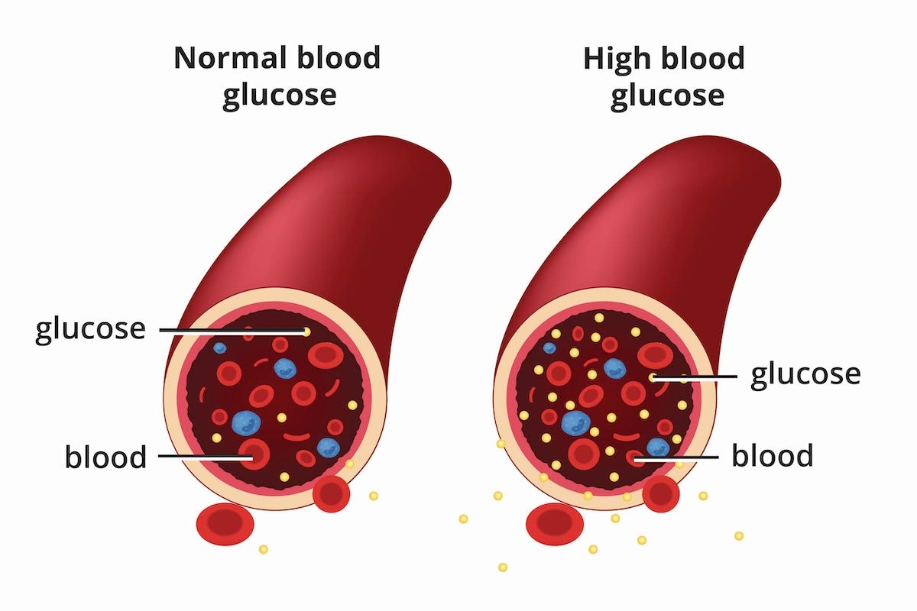
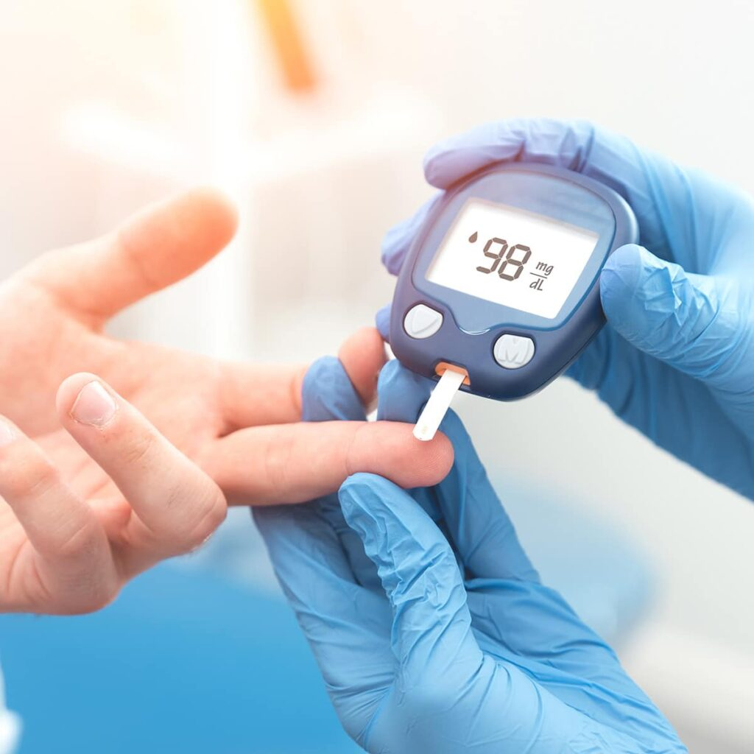
Content
Introduction
Literature Review
Objectives
Methodology
Working Model
Results
Conclusion
References
Notes:
Throughout this presentation , we will cover the following topics: 1. Various literature references 2. Objectives 3. Methods and Working Models used 4. and driving results with conclusion

Slide 3
Introduction
A chronic condition that affects millions of people worldwide.
Early diagnosis and drug management are crucial to prevent future complications.
Predicting diabetes using machine learning models can significantly improve the accuracy and speed of diagnosis.
In 2023, over half a billion people were standing affected by diabetes.
In India, 10.1 crore population out of the total was diagnosed with diabetes.
The increase is projected to 1.3 billion in the next 30 years.
Notes:
Diabetes is a chronic condition that affects people all over the globe. Thus it’s the crucial need of the hour to develop systems that can catch the onset of the disease before it’s onset.

Slide 4
Challenges in Manual Diagnosis:
Challenges include:
Traditional diagnostic methods
Manual review of patient data (blood tests, medical history)
Time-consuming manual inspections
Risk of human error in evaluating test results and symptoms
Limited ability to process large volumes of patient data efficiently
Need for more accurate, efficient, and automated systems
Notes:
Several challenges include:
Manual identification and diagnosis
Inefficient drug management and administration.
Involved risk of human error.

Slide 5
Machine Learning Approach:
Objective: Build models using machine learning algorithms to predict diabetes and recommend medicines.
Features used for prediction: Pregnancies, Glucose, Blood Pressure, Skin Thickness, Insulin, BMI, Diabetes Pedigree Function, Age.
Models used:
Support Vector Machine (SVM)
Random Forest Classifier
Logistic Regression
These models provide early and accurate detection, reducing diagnostic time and improving treatment outcomes.

Slide 6
Literature Review
S.no | Author | Year | Title | Source | Description (Findings of the Study)
1 | Mounika et al. | 2024 | Diabetes prediction using machine learning and explainable AI | NCBI | This study implemented advanced feature selection and various machine learning models on the Pima Indian and LMCH Iraqi datasets. The deep neural network (DNN) achieved the highest accuracy of 0.973 for the LMCH dataset. The study emphasized the importance of preprocessing techniques and hyperparameter tuning, noting that Random Forest also performed well with an accuracy of 90% compared to other algorithms.
2 | Kim et al. | 2023 | Comparisons of the prediction models for undiagnosed diabetes | Scientific Reports | This research demonstrated that ML-based models outperformed traditional statistical methods in predicting undiagnosed diabetes, achieving an AUC of 0.819 compared to 0.765 for traditional methods. The study utilized data from the Korean National Health and Nutrition Examination Survey, highlighting the effectiveness of machine learning in clinical settings.

Slide 7
Literature Review
S.no | Author | Year | Title | Source | Description (Findings of the Study)
3 | Wu et al. | 2022 | Machine Learning Models for Data-Driven Prediction of Diabetes | NCBI | This paper compared five ML models (CATBoost, XGBoost, RF, LR, SVM) using lifestyle data from NHANES, finding CATBoost had the highest performance with an AUC of 0.83 and accuracy of 82.1%. The study illustrated how lifestyle-related variables can significantly enhance diabetes prediction capabilities in machine learning frameworks.
4 | Rahman et al. | 2023 | Diabetes prediction using machine learning and explainable AI | NCBI | This research explored various ML techniques, including extreme gradient boosting for predicting diabetes risk using a private dataset. It highlighted the effectiveness of semi-supervised learning approaches and emphasized the need for explainable AI techniques in healthcare applications to improve understanding and trust in predictive models.

Slide 8
Objective
Early and Accurate Detection: Develop a model that analyzes healthcare data or ultrasound images to detect and classify thyroid abnormalities.
Focus: Detect nodules, cysts, and other irregularities early on.
Benefit: Aids in timely and precise diagnosis, allowing for better treatment planning.
Enhanced Diagnostic Efficiency: Implement an automated system to support radiologists in diagnosing thyroid disorders.
Focus: Reduce manual analysis time and improve diagnostic consistency.
Benefit: Minimizes human error and accelerates the diagnostic process.

Slide 9
Methodology
Data Collection: Collect relevant healthcare data from patients, such as medical history, blood tests, and demographic details. Ensure the dataset includes both diabetic and non-diabetic cases, with proper labeling for accurate model training.
Data Preprocessing: Clean the data by removing missing or inconsistent values and normalize numerical features to ensure consistency. Apply techniques like oversampling or undersampling to handle imbalanced data for better model performance.
Feature Extraction: Identify key features from the dataset, such as glucose levels, blood pressure, BMI, and insulin levels. Use feature engineering techniques to enhance the dataset's predictive power or leverage automated feature extraction through deep learning models.
Model Selection: Choose machine learning models, such as SVM, Random Forest, Logistic Regression, or deep learning models for diabetes prediction. Select models based on performance in early experiments.

Slide 10
Model Training and Validation: Split the dataset into training, validation, and testing sets. Train the models using the training data, fine-tune hyperparameters using the validation set, and measure performance through cross-validation techniques.
Model Evaluation: Evaluate the models using metrics such as accuracy, precision, recall, and F1 score. Analyze the ROC-AUC curve to determine the model's diagnostic effectiveness, ensuring robustness across various cases.
Model Deployment: Deploy the trained model into a healthcare system, allowing real-time predictions of diabetes risk. Integrate a medicine recommendation system based on patient profiles and clinical guidelines.
Continuous Monitoring and Improvement: Monitor the model’s performance post-deployment by collecting feedback and assessing real-world data. Regularly update the model using new patient data to improve accuracy and effectiveness in predicting diabetes and suggesting appropriate medication.

Slide 11
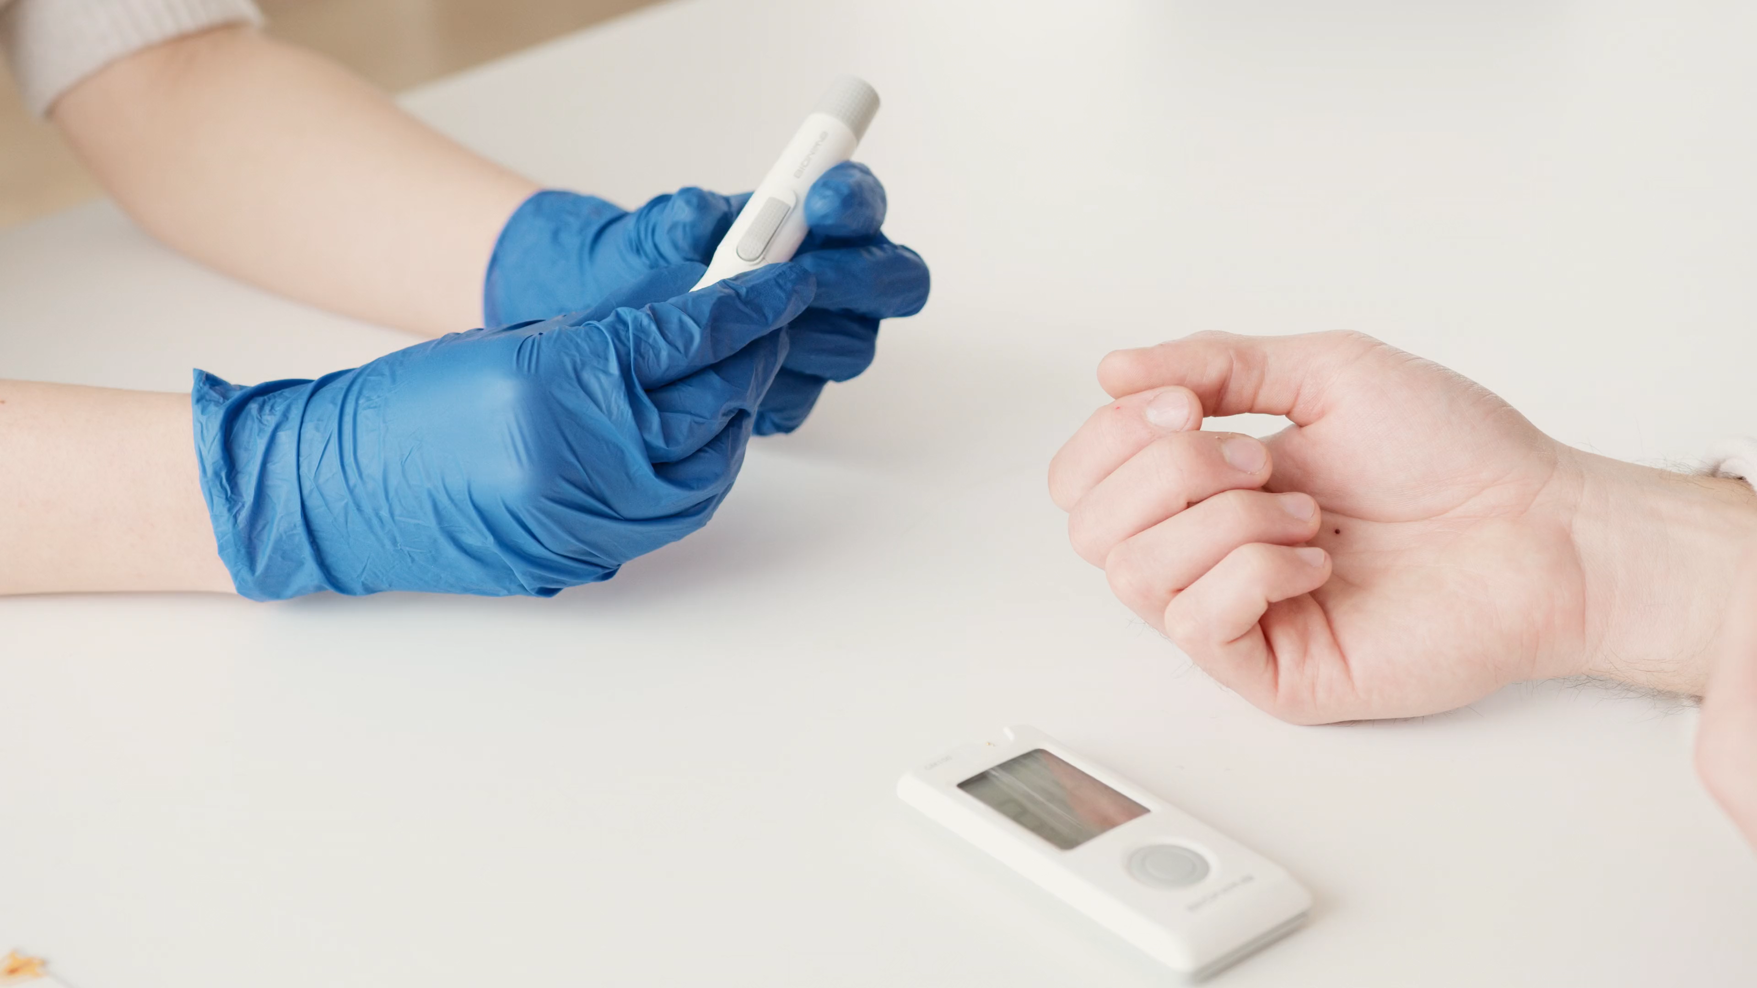
Diabetes Prediction and Medicine Recommendation
Dataset
Dataset Name: Diabetes Dataset
Source: Kaggle (diabetes.csv)
Size: Training Instances: 2800
Test Instances: 972
Attributes: 8 features including:
Pregnancies
Glucose
Blood Pressure
Skin Thickness
Insulin
BMI (Body Mass Index)
Diabetes Pedigree Function
Age
Outcome Variable:
0 = Non-Diabetic
1 = Diabetic
Dataset link: https://www.kaggle.com/datasets/mathchi/diabetes-data-set?resource=download

Slide 12
Diabetes Prediction and Medicine Recommendation
Dataset
Key Characteristics:
Data Types: Continuous and Boolean attributes.
Missing Values: Presence of missing data in several attributes, requiring preprocessing.
Statistical Summary: Mean, median, and other descriptive statistics to be analyzed.
Example Data Points:
Pregnancies | Glucose | Blood Pressure | Skin Thickness | Insulin | BMI | Diabetes Pedigree Function | Age | Outcome
6 | 148 | 72 | 35 | 0 | 33.6 | 0.627 | 50 | 1
1 | 85 | 66 | 29 | 0 | 26.6 | 0.351 | 31 | 0
... | ... | ... | ... | ... | ... | ... | ... | ...

Slide 13
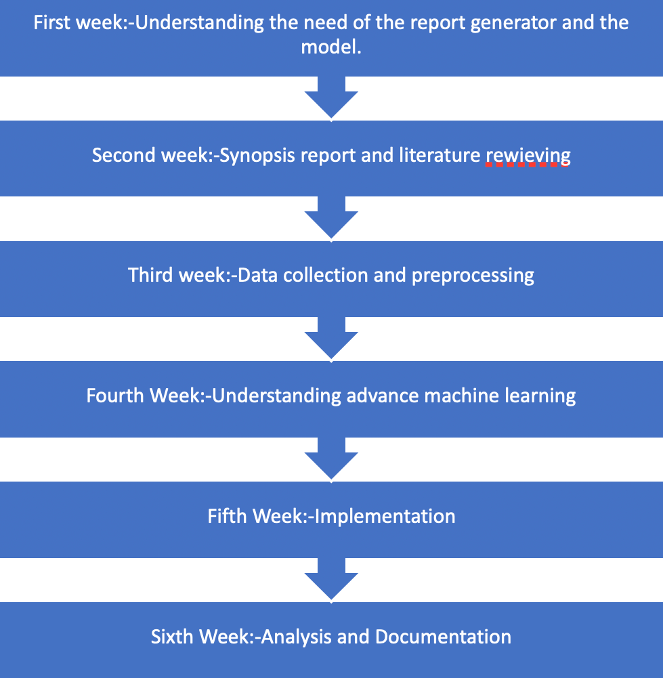
Timeline
reviewing

Slide 14
Inference From Literature
Kim et al. (2023): This study compared various machine learning models for predicting undiagnosed diabetes. It found that machine learning models significantly outperformed traditional statistical approaches, achieving an AUC of 0.819 compared to 0.765 for traditional models, indicating a more effective method for risk assessment.
Khanam et al. (2023): The authors introduced a diabetes prediction model utilizing Boruta feature selection. Their approach achieved up to 98% accuracy on the PIMA diabetes dataset, highlighting the critical role of feature selection and data preprocessing in enhancing model performance.
Wu et al. (2022): The study evaluated five machine learning models, including CATBoost and XGBoost, using NHANES lifestyle data. CATBoost achieved the highest performance with an AUC of 0.83 and accuracy of 82.1%, underscoring the potential of lifestyle-related variables in diabetes prediction.
Rahman et al. (2023): This paper presented a diabetes prediction system using various machine learning techniques on a private dataset from female patients in Bangladesh. The findings indicated effective prediction capabilities through semi-supervised learning approaches, showcasing the adaptability of machine learning in healthcare applications for diabetes management.
Overall Findings:
Machine learning models consistently outperform traditional statistical methods in predicting diabetes.
Feature selection and data preprocessing are crucial for improving model accuracy.
Advanced models may require more data and computational resources but can significantly enhance predictive capabilities.
The choice of model should balance complexity with available resources for optimal performance.

Slide 15
Sub Objective
Feature Extraction: Identify key features in the diabetes dataset that are indicative of diabetes risk, including factors such as glucose levels, BMI, insulin levels, and family history.
Model Development: Create and optimize a machine learning model for accurate classification of diabetes status (diabetic vs. non-diabetic) using various algorithms such as Logistic Regression, Random Forest, and CatBoost.
System Integration: Develop an automated tool that integrates seamlessly into healthcare providers’ workflows to facilitate real-time diabetes risk assessment and medicine recommendations based on patient data.
Validation: Test the developed model on independent datasets to ensure its accuracy, reliability, and generalizability across different populations.
User Training: Provide comprehensive training and support for healthcare professionals to effectively use the system, interpret results, and make informed decisions regarding patient care.

Slide 16
Deliverable of Each Steps or Phases
Data Collection: Acquired a comprehensive dataset containing health metrics from diabetic and non-diabetic patients.
Data Preprocessing: Completed cleaning, normalization, and standardization of the dataset to improve model accuracy.
Model Selection and Training: Trained multiple machine learning models including SVM, Random Forest, Logistic Regression, and CatBoost for diabetes classification.
Model Evaluation: Evaluated models using accuracy metrics and determined the best-performing models for deployment.
Medicine Recommendation System: Implemented logic for medication recommendations based on diabetes severity.

Slide 17
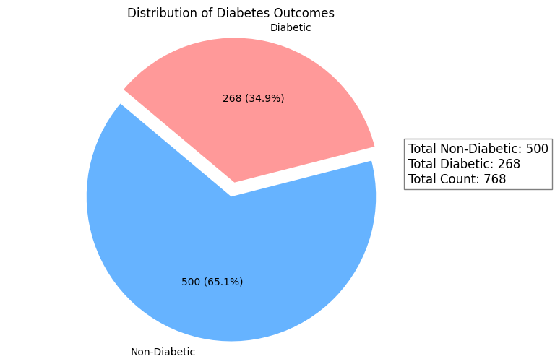
Total Number of Diabetic and Non Diabetic Values

Slide 18
Working Module
Start
Data Gathering
Data Preprocessing
Model Design
Model Implementation
Model Training
HyperParameter Tuning
Model Evaluation
Model Deployment
User Interface Design
Model Monitoring
Model Maintenance and Updates
End

Slide 19
Model Used
SVM : Support Vector Machines (SVMs) are powerful supervised learning algorithms primarily used for classification and regression tasks. SVM work by identifying the optimal hyperplane that separates data points of different classes in a high-dimensional space, maximizing the margin between the closest points of each class, known as support vectors.
Random Forest : Random Forest is a powerful and versatile supervised learning algorithm used for both classification and regression tasks. Random Forest is a powerful and versatile supervised learning algorithm used for both classification and regression tasks.
Logistic Regression : Logistic regression is a statistical method used for binary classification tasks, where the goal is to predict the probability of a binary outcome based on one or more independent variables. Logistic Regression is a supervised learning algorithm that models the relationship between a dependent binary variable and one or more independent variables by estimating probabilities using a logistic function. It is particularly useful for predicting outcomes that can take on two possible values, such as "yes/no," "success/failure," or "0/1."

Slide 20
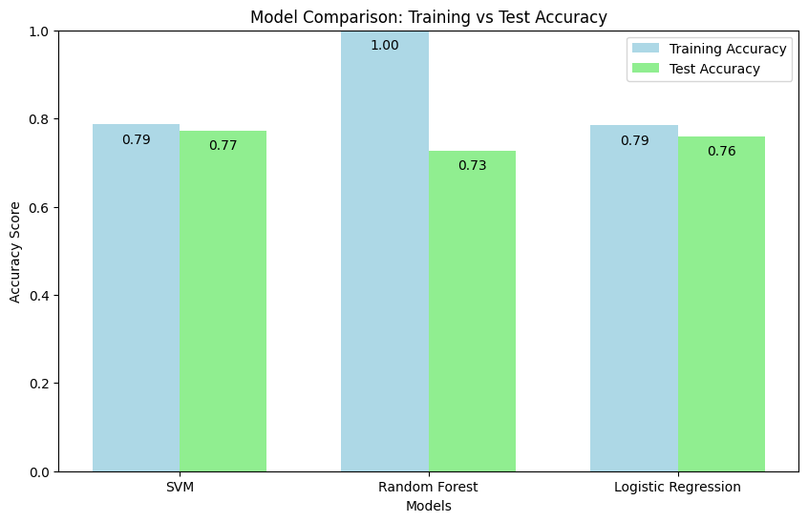
Model Comparison: Training vs Test Accuracy

Slide 21
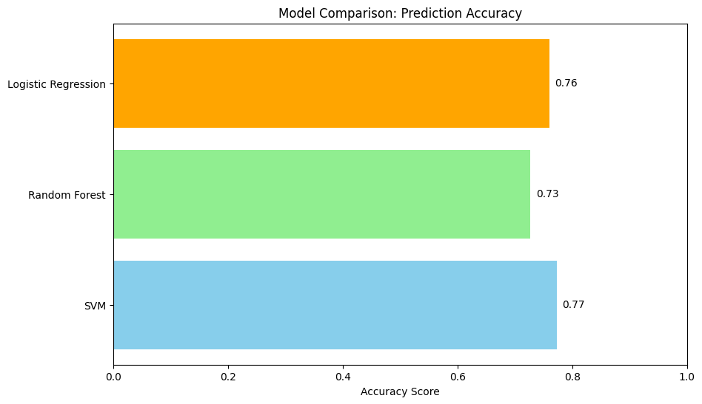
Model Comparison: Prediction Accuracy
Various machine learning models were employed:
SVM achieved an accuracy of 77% on test data.
Random Forest achieved an accuracy of 73% on test data.
Logistic Regression achieved an accuracy of 76% on test data.

Slide 22
Attained Deliverables
Trained Machine Learning Model: A fully trained Machine Learning model designed to predict diabetes outcomes based on various health parameters, demonstrating high accuracy, sensitivity, and specificity for reliable clinical use.
Web-Based Application: An intuitive web application that enables healthcare professionals to input health parameters for diabetes risk assessment, providing real-time predictions and personalized medicine recommendations.
Comprehensive Documentation: Thorough documentation that includes a user manual for effective system utilization, along with technical specifications detailing model architecture, data preprocessing techniques, and deployment requirements.
Validation Report: A detailed validation report comparing the model’s predictions with expert diagnoses, including key performance metrics such as accuracy, precision, recall, and F1 score, showcasing the model’s effectiveness in identifying diabetes risk and recommending appropriate interventions.

Slide 23
Conclusion
Enhanced Accuracy: The developed system leverages advanced deep learning techniques to improve the accuracy of diabetes predictions, facilitating early detection and intervention.
Informed Decision-Making: By providing reliable predictions, the system supports medical professionals in making informed decisions regarding patient care and treatment options.
Continuous Improvement: The proposed system is designed for easy updates with new data, ensuring it remains effective as medical knowledge and technology evolve.
Long-Term Utility: Its adaptability enhances long-term utility in clinical settings, providing ongoing value in diabetes management and patient health outcomes.
User-Friendly Interface: The intuitive web application allows healthcare providers to efficiently input data and receive actionable insights, streamlining the diagnostic process.

Slide 24
Reference
1. Pima Indians Diabetes Database: UCI Machine Learning Repository. Available at: [UCI Repository https://archive.ics.uci.edu/ml/datasets/diabetes
2. Cleveland Clinic Foundation: "Diabetes Risk Assessment." Available at: [Cleveland Clinic](https://my.clevelandclinic.org/health/diseases/9473-diabetes)
3. LIME (Local Interpretable Model-agnostic Explanations): Ribeiro, M.T., Singh, S., & Guestrin, C. (2016). "Why Should I Trust You?" Explaining the Predictions of Any Classifier. In Proceedings of the 22nd ACM SIGKDD International Conference on Knowledge Discovery and Data Mining.
4. SHAP (SHapley Additive exPlanations): Lundberg, S.M., & Lee, S.I. (2017). "A Unified Approach to Interpreting Model Predictions." In Proceedings of the 31st International Conference on Neural Information Processing Systems.
5. Support Vector Machines: Cortes, C., & Vapnik, V. (1995). "Support-Vector Networks." Machine Learning, 20(3), 273-297.

Slide 25
Reference
6. Streamlit Documentation: Streamlit Team. (2021). "Streamlit: The Fastest Way to Build Data Apps." Available at: [Streamlit](https://docs.streamlit.io/)
7. Machine Learning in Healthcare: Rajkomar, A., Dean, J., & Kohane, I. (2019). "Machine Learning in Medicine." New England Journal of Medicine, 380(14), 1347-1358.
8. Feature Selection Techniques: Guyon, I., & Elisseeff, A. (2003). "An Introduction to Variable and Feature Selection." Journal of Machine Learning Research, 3, 1157-1182.
9. Evaluation Metrics for Classification Models: Sokolova, M., & Lapalme, G. (2009). "A Systematic Analysis of Performance Measures for Classification Tasks." Information Processing & Management, 45(4), 427-437.
10. Diabetes Prevention Programs: Diabetes Prevention Program Research Group. (2002). "Reduction in the Incidence of Type 2 Diabetes with Lifestyle Intervention or Metformin." New England Journal of Medicine, 346(6), 393-403.

Slide 26
Reference
11.Mounika, K., Sridevi, K., & Prakash, A. K. (2024). Diabetes prediction using machine learning and explainable AI. NCBI.
12.Kim, H., Lee, J., & Kim, S. (2023). Comparisons of the prediction models for undiagnosed diabetes. Scientific Reports, 13(1), 40170.
13.Khanam, F., Saba, T., & Hussain, M. (2023). A diabetes prediction model based on Boruta feature selection. BMC Bioinformatics, 24(1), 76.
14.Wu, Q., Huang, Y., & Wang, Z. (2022). Machine Learning Models for Data-Driven Prediction of Diabetes. NCBI.
15.Rahman, M., Sultana, N., & Kadir, M. (2023). Diabetes prediction using machine learning and explainable AI. NCBI.

Slide 27
Thank You

